Slide 1
Properties of Regular Languages
Closure properties
Distinguishable strings
The pumping lemma

Slide 2
Closure Under Kleene Operations
If L₁ and L₂ are regular, then L₁ + L₂ = L₁ U L₂ is regular
Let L₁ be the language of regular expression R₁
Let L₂ be the language of R₂
By definition, L₁ + L₂ is the language of R₁+R₂
So L₁ + L₂ is regular
If L₁ and L₂ are regular, then L₁ L₂ is regular
If L is regular, then L* is regular

Slide 3
Closure Under Complement
If L is a regular language, then so is its complement L
Since L is regular, it has a DFA
Modify the DFA by making all accept states into non-accept states and vice-versa
The resulting DFA accepts the complement of L
Therefore the complement of L is regular

Slide 4

Closure Under Intersection
If L₁ and L₂ are regular languages, then so is their intersection L₁ $∩$ L₂
By de Morgan’s Law, the intersection of two sets L₁ and L₂ is the complement of the [ union of the complements of L₁ and L₂ ]
The complements of L₁ and L₂ are regular
Therefore the union of these two complements is regular
Therefore the complement of this union is regular

Slide 5
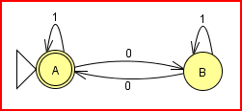
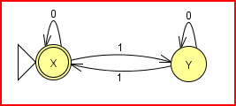
Constructing the Intersection of DFAs
Complement the first DFA
Complement the second DFA
Take the union by adding a common start state with epsilon transitions
Convert the resulting NFA into a DFA (why is this necessary?)
Complement this DFA

Slide 6
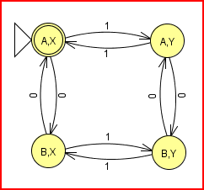
Constructing the Intersection of DFAs
Make a DFA where each state corresponds to one of the pairs of states from the two DFAs above

Slide 7
Distinguishable Strings
Let L be a language and let x and y be strings.
We say that x and y are distinguishable with respect to L if there is some string z such that xz belongs to L but yz does not (or vice versa).
Example 1: Let L be the language of binary strings where each string starts with n 0’s and ends with n 1’s (0^{n}1^{n}). What are some pairs of distinguishable strings?
Example 2: Let L be the language of binary strings where each string is an even-length palindrome (ww^{R}). What are some pair of distinguishable strings?

Slide 8
Distinguishable Strings
Theorem: Let L be a language. If x and y are distinguishable with respect to L, then any DFA for L must be in a different state after consuming x than it is after consuming y.
Theorem: Let L be a language. If there is a set D of strings, each pair of which is distinguishable with respect to L, then any DFA for L must have at least |D| states. (What if D is infinite?)
Prove: The language 0^{n}1^{n} is not regular.
Proof: Consider the set {0, 00, 000, …}. These strings are pairwise distinguishable (why?). Therefore the language is not regular (why?).

Slide 9
Pumping Lemma (for regular languages)
Let L be a regular language accepted by a DFA with k states. Then any string z in L where |z| ≥ k can be split as uvw where
v is non-empty
|uv| ≤ k
uv^{i}w is in L for all i ≥ 0
v
P
R
u
w
Q

Slide 10
Pumping Lemma
Let L be the language 0^{n}1^{n}. Assume L is regular with a DFA that contains k states. Let z be the string 0^{k}1^{k} .
Consider any “legal” split of z = uvw. Since |uv| ≤ k, v must consist entirely of one or more 0’s.
By the pumping lemma, uv^{i}w must be in L for all i ≥ 0, and in particular for i = 0. But uv⁰w = uw is not in L because it contains fewer 0’s than 1’s.
Therefore the assumption that L is regular is wrong.
v is non-empty
|uv| ≤ k
uv^{i}w is in L for all i ≥ 0

